Slide 1
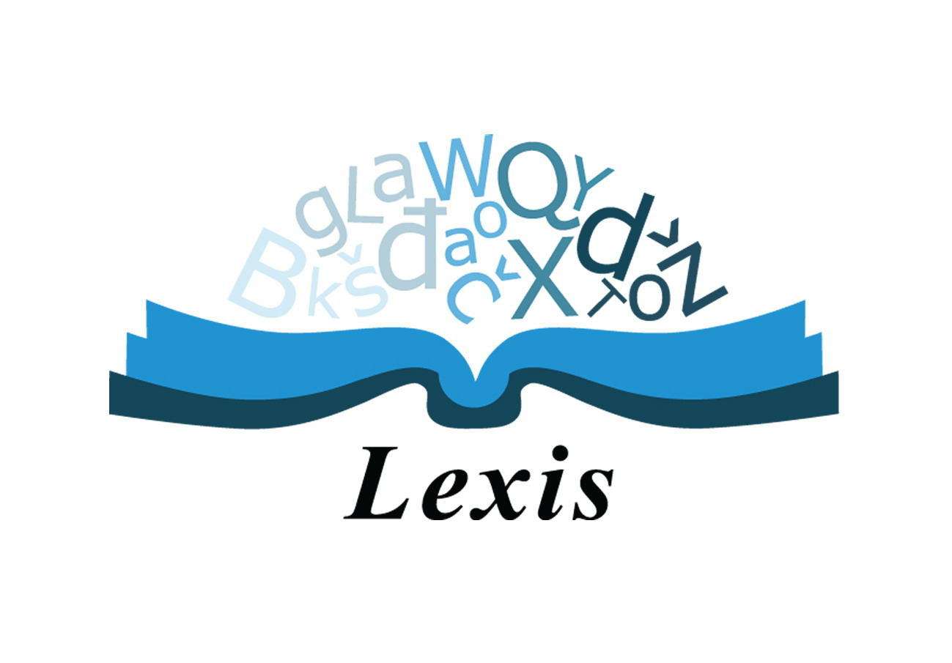
Teaching lexis in ESP
Teaching Vocabulary in ESP

Slide 2
Outline
The importance of vocabulary in ESP course
Types of vocabulary
Active and passive vocabulary
More vocab teaching aspects

Slide 3
 | ESP | GE
Vocabulary | 20% | 10%
Grammar | 10% | 20%
Pronunciation | 5% | 5%
Functional Language | 20% | 5%
Reading | 5% | 10%
Writing | 5% | 10%
Listening | 10% | 10%
Speaking | 20% | 20%
Other | 5% | 10%
Total | 100% | 100%

Slide 4
Importance of vocabulary in ESP

Slide 5
Types of vocabulary
Target
Non-target
Emergent

Slide 6
Sources of vocabulary
Technical dictionary or glossary
Authentic reading and listening texts incorporated into the course
Respected text books
Learners themselves

Slide 7
Amount of vocabulary
How many words do you usually give your students to learn per lesson?
10
20
15

Slide 8
Active and passive vocabulary
administrator benefactor beneficiary codicil dependants estate executor inherit inheritance intestate will power of attorney probate testament trust trustee damages commit offence claimant evidence fine injunction
Active Vocabulary Administrator commit Will offence Estate evidence Executor testament Enherit fine Inheritance claimant Probate Trust damages | Passive Vocabulary Benefactor Beneficiary Dependant injunction trustee | I don’t know these words Codicil power of attorney Probate intestate

Slide 9
a) I want to be able to use words well
Non-vocabulary
I want to understand them
Passive vocabulary
I want to be able to use words well
Active vocabulary
I don’t need to know them
I don’t need to know them
I don’t need to know them

Slide 10
Vocab priorities
Continue teaching words/phrases Ss already know passively
Explain rationale
Keep expectations reasonable
Keep expectations in mind when devising assessments
Teach words several times before Ss use them fluently

Slide 11
Word combinations
Dependent prepositions
compounds
collocations
Lexical sets
patterns

Slide 12
4.4 Examples of Collocations

Slide 13
Other things to teach
Types of meanings (semantic and pragmatic)
Different registers
Denotation
Connotation
Word formation
Synonyms
Antonyms

Slide 14
3.1 Types of Meaning

Slide 15
Ah … NOW I know that word!
Spelling
Pronunciation
Changes in word stress
Parts of speech
Grammatical patterns
Collocations
False friends
Level of frequency
Etymology
Translation
Synonyms
Antonyms
Different meanings depending on context
Definition

Slide 16
THANK YOU FOR YOUR ATTENTION

